Slide 1
Monopoly (Part 1)
Chapter 21

Slide 2
The Theory of Monopoly
The theory is based on three assumptions:
There is one seller.
The single seller sells a product for which there is no close substitute
There are extremely high barriers to entry

Slide 3
Barriers to Entry: A Key to Understanding Monopoly
Legal Barriers: Three types:
Public Franchise is a right granted to a firm by government that permits the firm to provide a particular good or service and excludes all others from doing the same.
Patents
Licenses
Economies of Scale: In some industries, low average total costs are only obtained through large scale production. If only one firm can survive in that industry, the firm is called a Natural Monopoly.
Exclusive Ownership of a Necessary Resource: Existing firms may be protected from entry of new firms by the exclusive or near-exclusive ownership of a resource needed to enter the industry

Slide 4
What is the Difference Between a Government Monopoly and a Market Monopoly?
Some economists use the term government monopoly to refer to monopolies that are legally protected from competition through Patents, Licenses, Public Franchises 🡺 Legally Prohibited.
The term market monopoly to refer to monopolies that are not legally protected from competition. The barriers take form of Economies of Scale and Exclusive ownership of resource.

Slide 5
Monopoly Pricing and Output Decision
A monopolist is a PRICE SEARCHER.
Price Searcher: A seller that has the ability to control to some degree the price of the product it sells.
Unlike the a Perfectly Competitive firm, it can raise price or lower prices and still sell the product.
This ability is determined by the demand curve it faces 🡺 which is also the market/industry demand curve 🡺 DOWNWARD SLOPING DEMAND CURVE

Slide 6
The Monopolist’s Demand and Marginal Revenue Curve
In the theory of monopoly, the monopoly firm is the industry and the industry is the monopoly firm. They are the same
Note that the price of the good being sold is greater than the marginal revenue. P>MR
To sell an additional unit of a good (per time period), the monopolist must lower price.
The monopolist gains and loses by lowering price.
The gain equals the price of the product times one.
The loss equals the difference between the new lower price and the old higher price times the units of output sold before the price was lowered.
Marginal revenue can be defined as revenue gained minus revenue lost
P=Revenue gained, MR=Revenue Gained – revenue lost, and revenue lost is >0. Therefore, P>MR

Slide 7
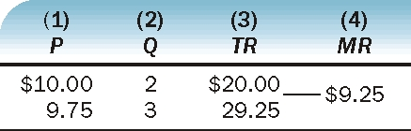
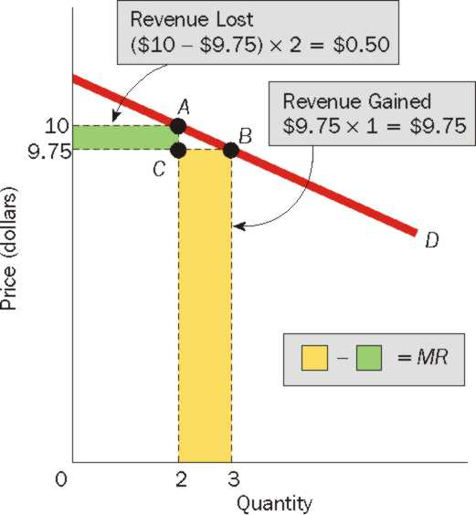
To sell an additional unit of the good, a monopolist needs to lower price. This price reduction both gains revenue and loses revenue for the monopolist. In the exhibit, the revenue gained and revenue lost are shaded and labeled. Marginal revenue is equal to the larger shaded area minus the smaller

Slide 8
The Monopolist’s Demand and Marginal Revenue Curves are NOT Same
In Perfect Competition: P = MR
In Monopoly: P > MR
Price is determined by Demand. So Demand Curve lies ABOVE MR curve.
For first unit, P = MR, for second unit onwards, P > MR
Therefore: In monopoly, the firm’s demand curve is not the same as its marginal revenue curve. The monopolist’s demand curve lies above its marginal revenue curve

Slide 9
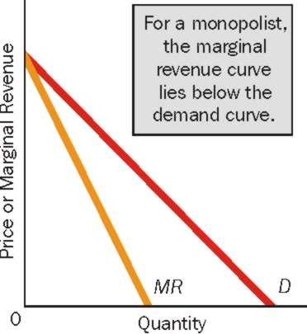
The Monopolist’s Demand and Marginal Revenue Curves are NOT Same

Slide 10
Price and Output for a Profit-Maximizing Monopolist
Profit Maximizing Condition: MR = MC
The monopolist that seeks to maximize profits produces the quantity of output at which MR=MC and charges the highest price per unit at which this quantity of output can be sold.
A monopolists can also make profits and loses, after taking into consideration Average Total Costs.
A monopolist can occur a loss if the highest possible price charged at MR = MC is less than the ATC at that point

Slide 11
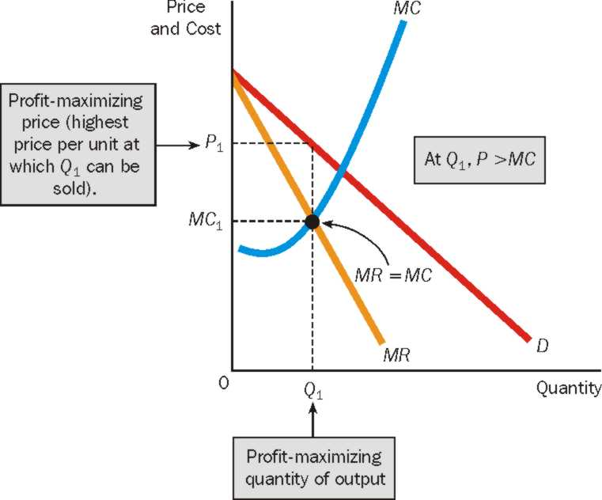
The Monopolist’s Profit-Maximizing Price and Quantity of Output
The monopolist produces the quantity of output (Q₁) at which MR=MC, and charges the highest price per unit at which the quantity of output can be sold (P₁). Notice that at the profit maximizing quantity of output, price is greater than marginal cost, P>MC.

Slide 12
If a Firm Maximizes Revenue, Does it Automatically Maximize Profit Too?
Given TR = $100, TFC = $40, TVC = $20. What is the profit?
Let one more unit of good is produced. TR increases to $105, TFC = $40, TVC = $30. What is the profit?
Has profit risen or fallen?
Let one more unit of good is produced. TR increases to $105, TFC = $40, TVC = 0 [in both cases]. What is the profit?
Conclusion: Maximizing revenues is the same as maximizing profits only when a firm has no variable costs. It is unlikely, though, that a firm will be without variable costs.

